Slide 1
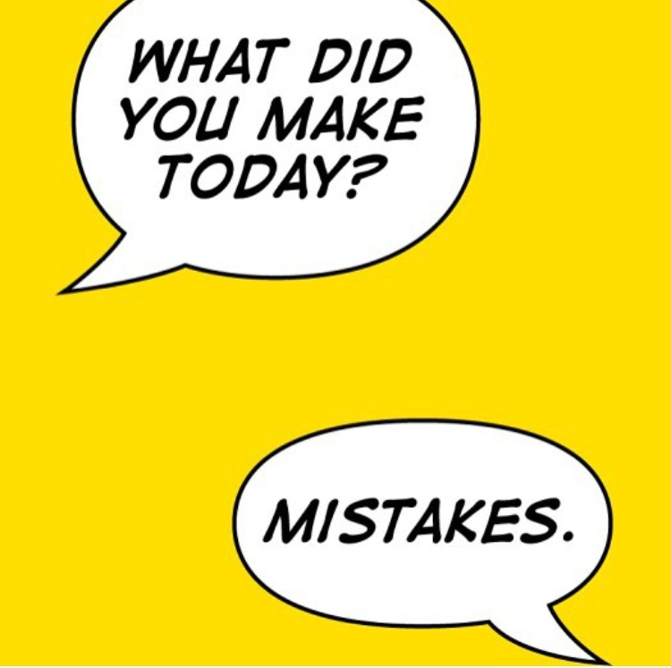
Huiswerk
Doorlezen: Giancoli §39.1-6 & §39.8+9; & §40.1-5
Maak Problems: 40_{4,5,10,11,17, 62, 63}
Maak de opgaven uit 'Week 3' in MP
Huiswerkbespreking: vrijdag
welkom mits voorbereid!
Problem 40.5: Berekenen van effect afscherming door e⁻-wolken op ionbinding:
Bekend: energie nodig om ionen te vormen.
Bindingsenergie blijkt lager dan verschil tussen ionisatie en de Coulomb-aantrekking (te benaderen via: ionen → puntladingen)
Reden van lagere bindingsenergie: e⁻-schillen stoten elkaar af.
MP
Notes:
Li+ ion, F- ion
According to the problem statement, 5.39 eV of energy is required to make an Li+ ion from neutral Li, and 3.41 eV of energy is released when an F atom becomes an F- ion. That means that a net energy input of 5.39 eV – 3.41 eV = 1.98 eV is needed to form the ions. We calculate the negative potential energy of the attraction between the two ions. = -9.21eV
The binding energy should therefore be 9.21 eV – 1.98 eV = 7.23 eV. But the actual binding energy is only 5.95 eV. Thus the energy associated with the repulsion of the electron clouds is 7.23 eV – 5.95 eV = 1.28 eV.

Slide 2
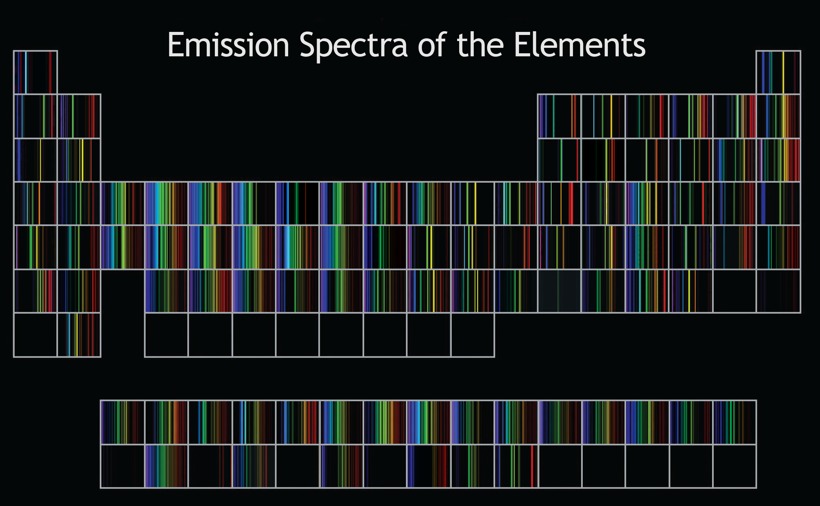
Vastestoffysica III
http://www.fieldtestedsystems.com/download/PeriodicTableOfSpectra.png
Saskia Blom
(s.blom@fontys.nl)

Slide 3
Inhoud college vandaag
HeNe-laser
Molecuulbinding
Van der Waalsbinding
Moleculaire spectra
Vaste stoffen

Slide 4
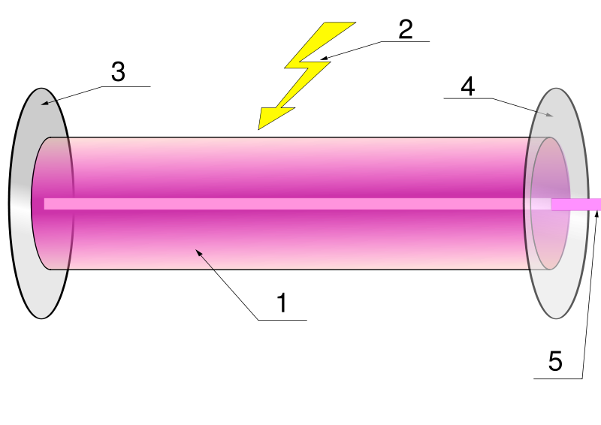
Quiz
Wat is gestimuleerde emissie?
Een e⁻ dat via optisch pompen is aangeslagen valt terug naar de grondtoestand.
Een aangeslagen e⁻ wordt door foton getriggerd om terug te vallen.
Een aangeslagen e⁻ valt terug via een verboden overgang
Er zijn meer aangeslagen e⁻ dan dat er e⁻ in de grondtoestand zijn.
spontane emissie
uitgezonden foton heeft zelfde golflengte, fase en richting
metastabiele toestand
populatie-inversie
Oefen met:
figuur natekenen
werking laser uitleggen
Notes:
We are looking for an intern to do research on material processing with an innovative Q-Switch CO2 laser.
De Run 5406 5504 DE Veldhoven tegenover ASML

Slide 5
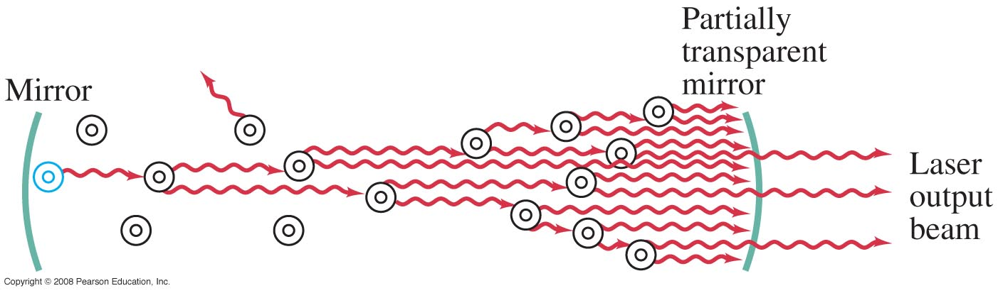
§39.9 Lasers:
optische oscillator: twee spiegels vormen trillingsholte (Fabry-Perot cavity)
versterking: pompen: energiebron (optisch, elektrisch, …)
➔ energieopslag in metastabiele toestand (verlaagde spontane emissie)
➔ dit zorgt voor populatie-inversie in het gain medium
➔ nu is gestimuleerde emissie mogelijk
Bij deze criteria zal een foton // hoofdas v.d. spiegels versterkt worden
→ coherente vlakke golf (zeer gericht): laserbundel
anders niet (meer)
zelfde fase & richting
waarom voorkomen
spontane emissie?
lawine-effect
Notes:
Lasermedium: http://www.enlightenyourmind.net/Graphics/laser2.jpggain medium, optical gain medium, active gain medium, active laser medium,
Active laser medium 2. Laser pumping energy 3. High reflector 4. Output coupler (partially reflecting) 5. coherent, intense plane wave
1 pompen + populatie inversie (energie toevoegen),
2 spiegels + metastabiele toestand (energie opslaan)
3 gestimuleerde emissie + gedeeltelijk doorlatende spiegel (vrijmaken energie via sneeuwbaleffect dat coherent licht oplevert)

Slide 6
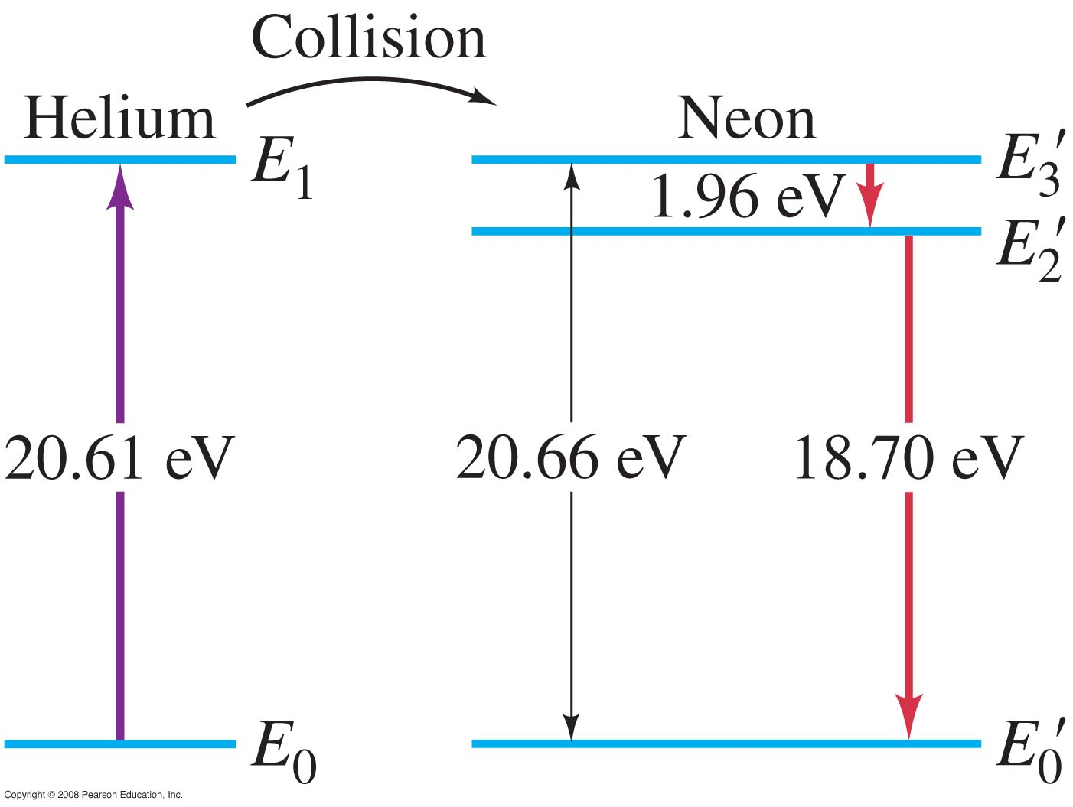

§39.9 HeNe-laser
A metastable state can also be created through interactions between two sets of atoms, such as in a helium—neon laser.
E_{3,Ne} = E_{1,He} + 0,05 eV
metastabiele
toestand
elektrisch
pompen
http://www.lexellaser.com/techinfo_wavelengths.htm
Notes:
Figure 39-21. Energy levels for He and Ne. He is excited in the electric discharge to the E₁ state. This energy is transferred to the E₃’ level of the Ne by collision. E₃’ is metastable and decays to E₂’ by stimulated emission.

Slide 7
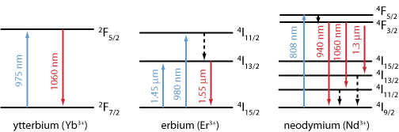
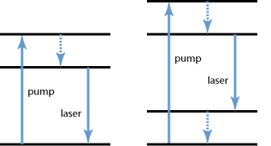
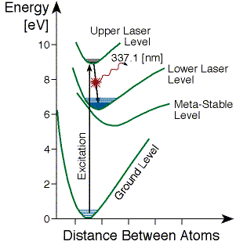
Lasertransities
3-level
4-level
(efficiënt)
medium
in grondtoestand
ondoorzichtig
l=6
l=3
als lower laser level (LLL)
lange levensduur →
grondtoestand ‘leeg’
pulsduur: 20 ns (levensduur ULL)
duur tussen pulsen 40 μs
(levensduur LLL)
pulsed
Nd:YAG
N₂
http://www.rp-photonics.com/laser_transitions.html
http://technology.niagarac.on.ca/people/mcsele/lasers/Quantum.htm
http://www.rp-photonics.com/ytterbium_doped_gain_media.html
Notes:
^{2S+1}L_{J} the crystal splits these into J + ½ sublevels.
A carbon-dioxide laser's output is brought about by rotational energy levels and occurs in the far infrared at 10.6 microns
http://technology.niagarac.on.ca/people/mcsele/lasers/Quantum.htm
Yb3+: http://www.rp-photonics.com/ytterbium_doped_gain_media.html
In a nitrogen laser, for example, the lasing transition is a vibronic one involving both electronic and vibrational levels. This leads to a gas laser transition with relatively broadband output (0.1nm) - many times wider than 'traditional' gas lasers. The energy levels defining this gas laser are really 'bands' where transitions can occur between these bands giving a range of possible wavelengths rather than a sharply defined line.
Erbium niet efficiënt maar nuttig voor glasfibers; Erbium-doped optical fibre amplifiers
Dye lasers usually involve all three mechanisms which leads to a continuum output over a given range. By tuning the feedback mechanism one can selectively amplify a given wavelength - these lasers are truly tunable.
Remember, too, that quantum mechanics can give rise to amazingly large numbers of closely-spaced levels. This happens in ion lasers (see below) where there are a number of laser transitions closely spaced (in the case of an argon ion laser, ten lasing lines appear in the blue-green-violet region).
Nd:YAG is een acroniem voor "neodymium-gedoteerd YAG-kristal" (Nd:Y3Al5O12), waarbij YAG staat voor yttrium-aluminium-granaat
To complicate matters there are also four-level lasers like the YAG. In the YAG laser energy absorbed by the laser rod pumps an upper energy level (actually two levels but who's counting :) which decays quickly (without radiating energy) to an upper laser level. From there neodymium atoms emit a photon at 1064nm (IR) and fall in energy to a lower laser state. Finally atoms at the lower state fall to ground state and the cycle begins again. Incidentally, the lasing transition in the YAG laser is from an 'F' level to an 'I' level (n=6 to n=3). Four levels are involved here: the upper pumped level, two lasing levels, and the ground level. Four level lasers are notoriously efficient. Main laser transition at 1064 nm
Level Lifetime
One problem that might be encountered along the way is the lifetime of lasing levels. Some levels have very long lifetimes (metastable). If the lower level of the lasing transition has a longer lifetime than the upper level then lasing action may not be possible at all or might be possible only in pulsed mode. Many practical lasers such as the nitrogen and copper-vapour laser have this situation. In both these cases, the upper-lasing levels can be preferentially filled, quickly, by a pulsed discharge of 100's of amperes or more! If the upper level fills quickly and population inversion can be achieved, lasing action will begin. Soon, though, the lower lasing level fills, the population at that level exceeding the upper level (and staying that way since it's lifetime is longer) and lasing ceases. In the case of the , lasing ceases after 10-20nS. In the copper-vapour laser, about 150nS. Both of these lasers operate strictly in pulsed mode and CW laser action cannot be achieved. %
N2-laser The metastable lower level lifetime is 40 μs (25 kHz), thus, the laser self-terminates, typically in less than 20 ns.
http://en.wikipedia.org/wiki/Nitrogen_laser
Ga naar: navigatie, zoeken
Q-switch is een Engelse term (Duits: Güteschalter) om een toestel aan te duiden dat van een continue (CW, Engels: Continuous Wave, Duits: Dauerstrich) laser (licht) korte, grote pulsen maakt (Duits: Riesenimpuls) door de kwaliteitsfactor (Engels: Quality factor) Q van laag naar hoog te schakelen. Doorgaans is het toestel een akoesto-optische modulator. Die bevindt zich in de laserresonator, dus binnen de spiegels. Als de modulator in de ene stand staat, is de kwaliteitsfactor Q van de resonator laag en gaat al het pompvermogen in de maximale populatie-inversie. Als dan de modulator naar de andere stand gaat, verhoogt Q naar de normale waarde en komt al de opgeslagen energie vrij in een korte puls (rond 100 nanoseconde). De modulator schakelt typisch aan een frequentie tussen 1 en 10 kHz. De Q-switch wordt veel gebruikt met een Nd:YAG laser.

Slide 8
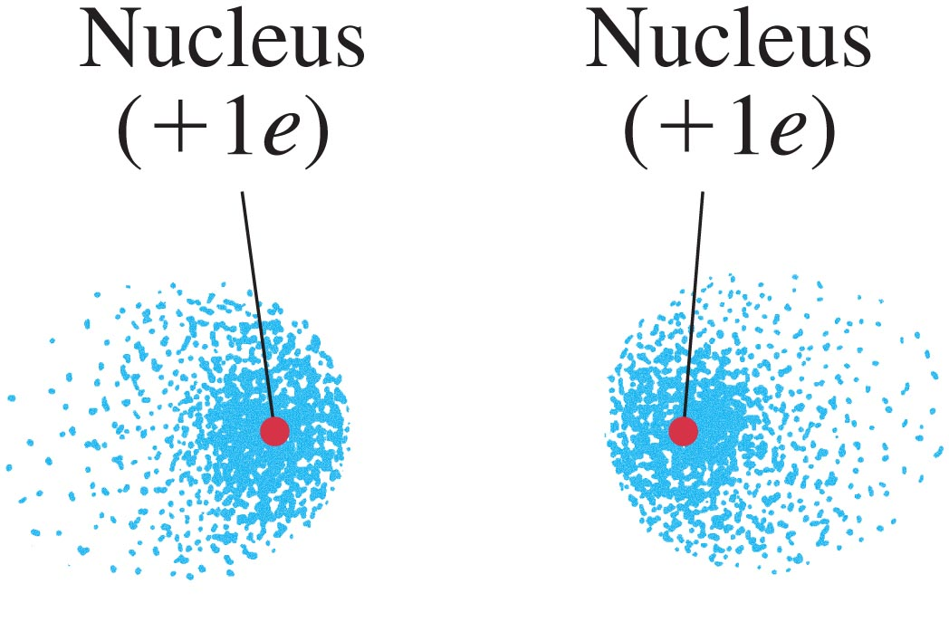
40.1 Bonding in Molecules
Hydrogen molecule, H₂, is bound covalently.
If the atoms have their spins in the same direction, so S = 1 for the molecule, the atoms will not bond due to the exclusion principle.
https://www.st-andrews.ac.uk/physics/quvis/simulations_html5/sims/FermionsBosons/FermionsBosons.html
Notes:
Figure 40-1a. Electron probability distribution (electron cloud) for two H atoms when the spins are the same (S = 1): (a) electron cloud.

Slide 9
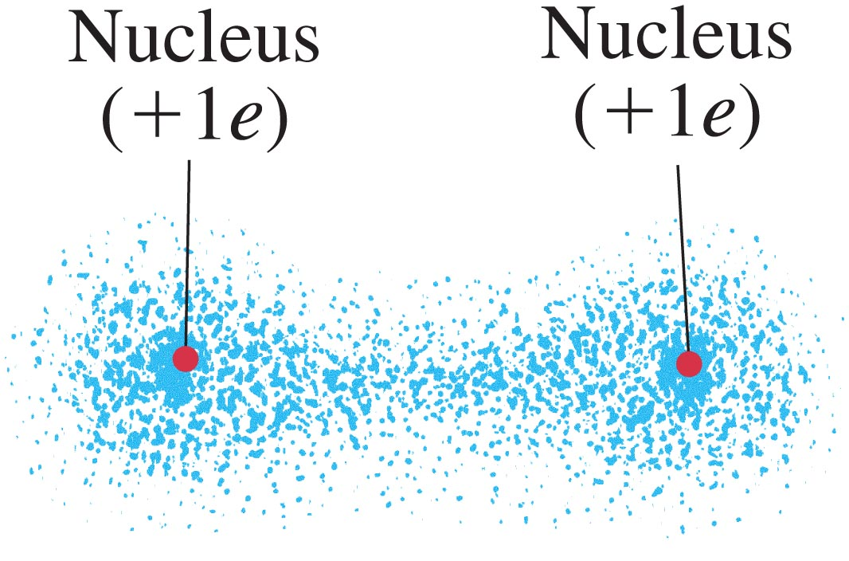
40.1 Bonding in Molecules
The molecule will form only if S = 0. The two electrons are shared by both atoms:
gedeelde e⁻
1 á 10 eV
The energy needed to separate the atoms is called the binding energy.
Notes:
Figure 40-2a. Electron probability distribution for two H atoms when the spins are opposite (S = 0): (a) electron cloud. In this case a bond is formed because the positive nuclei are attracted to the concentration of negative charge between them. This is a hydrogen molecule, H₂.

Slide 10
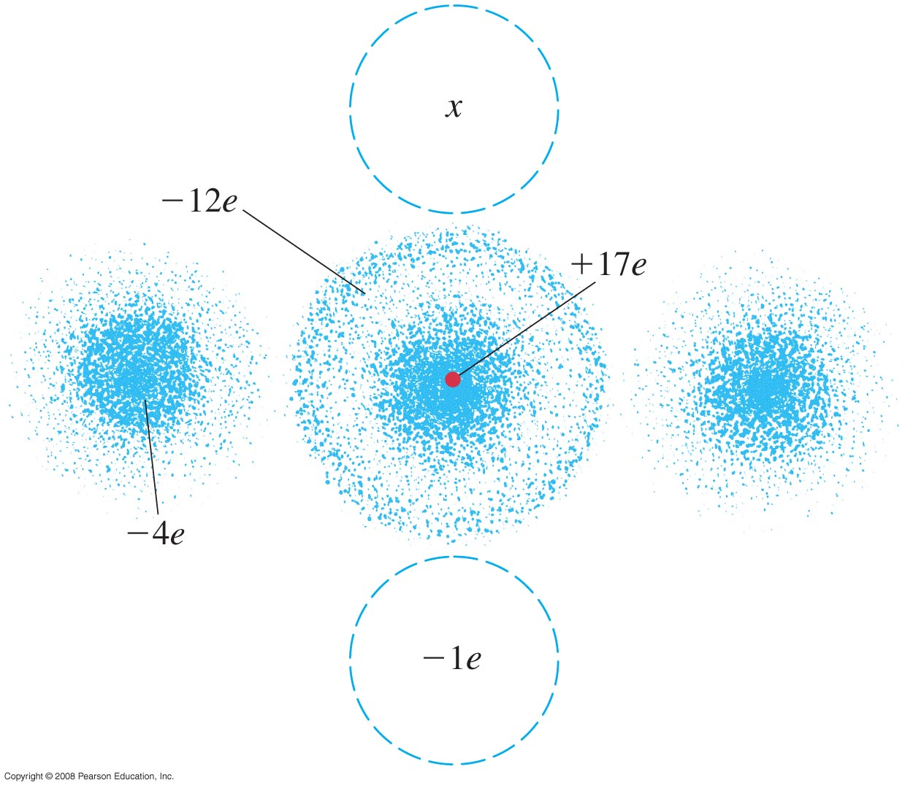
§40.1 Ionbinding
Na: 1 e⁻ buiten gesloten schil
Cl: plek voor één e⁻ :
¹¹Na 3s¹
¹⁷Cl 3s² 3p⁵
Cl-atoom
Notes:
Figure 40-5. Neutral chlorine atom. The +17e of the nucleus is shielded by the 12 electrons in the inner shells and subshells. Four of the five 3p electrons are shown in doughnut-shaped clouds, and the fifth is in the (dashed-line) cloud concentrated about the z axis (vertical). An extra electron at x will be attracted by a net charge that can be as much as ±5e.

Slide 11
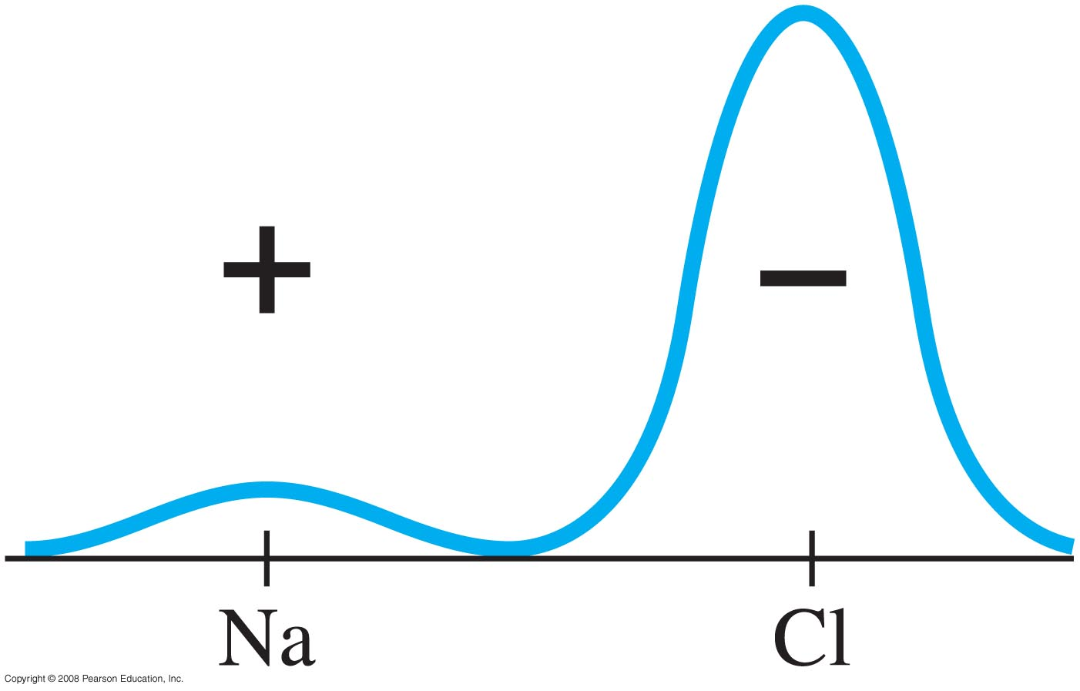
§40.1 Roosterbinding: keukenzout
An ionic bond is created by the attraction of ions.
For example, the outermost electron in the sodium atom spends most of its time around the chlorine atom in NaCl.
gestolen e⁻
3 á 4 eV
¹¹Na⁺
¹⁷Cl⁻
Notes:
Figure 40-3. Probability distribution |ψ|² for the outermost electron of Na in NaCl.
chloor 17 e-; 5 e- in 3 p toestand, 4 e- geven donut shape, vijfde e- is alleen
Na 11 e- 2, 8, 3s1

Slide 12
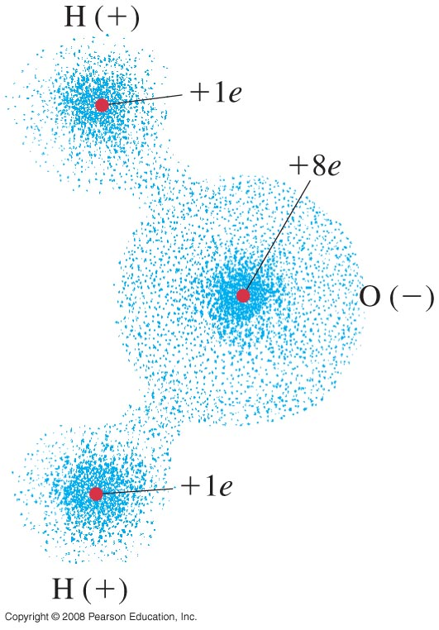
§40.1 Polaire binding
ion-achtig (polair)
vb: water
Notes:
Figure 40-6. The water molecule H₂O is polar.

Slide 13
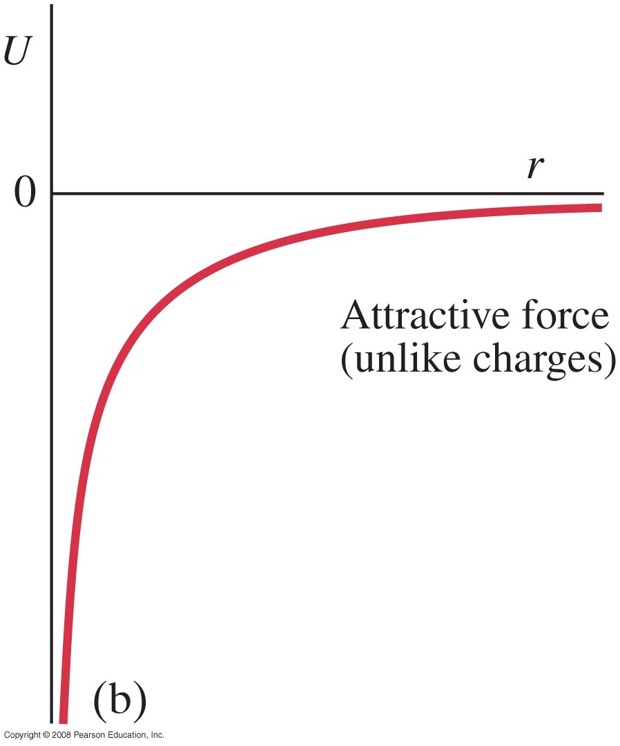
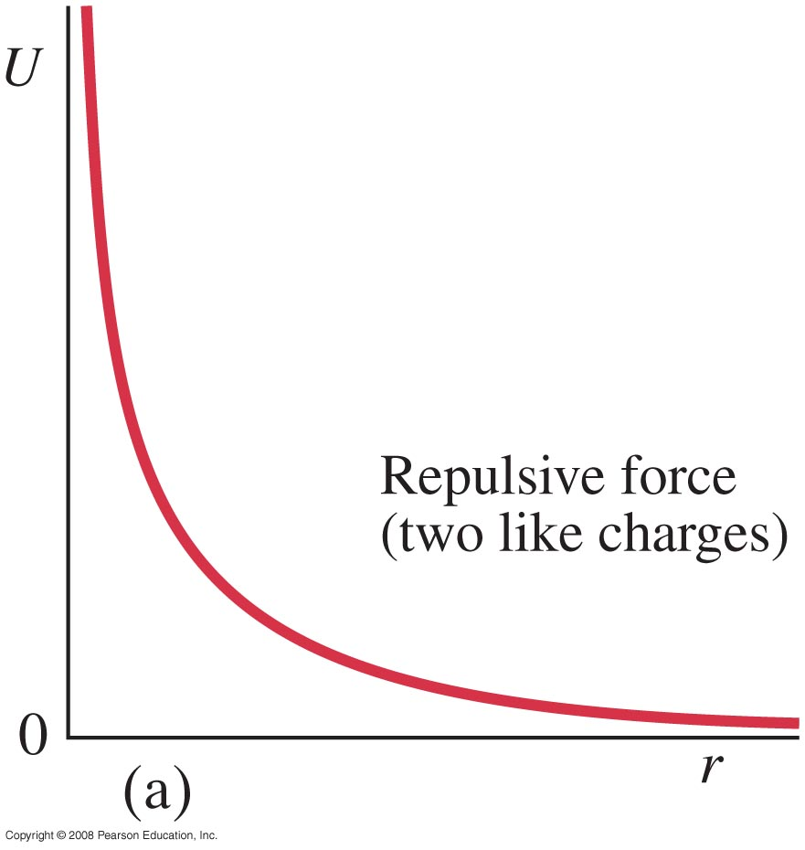
40.2 Potential-Energy Diagrams for Molecules
Potential energy of two point charges:
Notes:
Afstoting vooral Pauli!
Figure 40-7. Potential energy as a function of separation for two point charges of (a) like sign and (b) opposite sign.

Slide 14
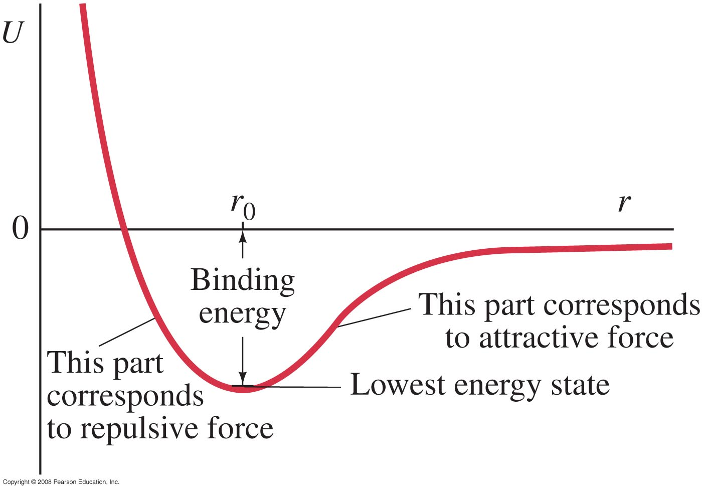
40.2 Potential-Energy Diagrams for Molecules
For the hydrogen molecule, the force between the atoms is attractive at large distances. If the atoms are too close, the electrons are too squeezed; therefore, there is a minimum in the potential.
Notes:
Figure 40-8. Potential-energy diagram for H₂ molecule; r is the separation of the two H atoms. The binding energy (the energy difference between U = 0 and the lowest energy state near the bottom of the well) is 4.5 eV, and r₀ = 0.074 nm.

Slide 15
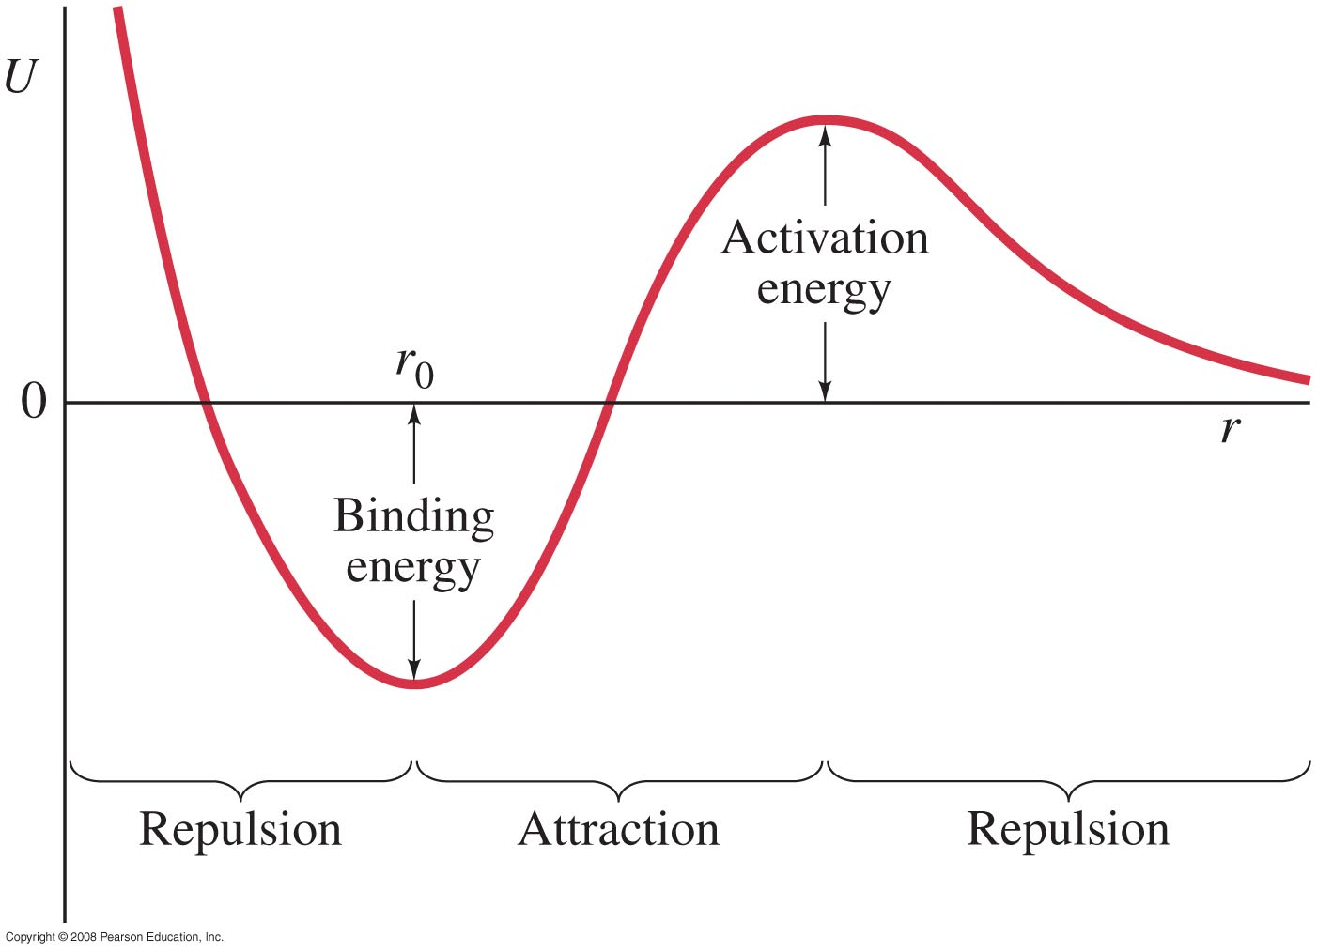
§40.2 Potentiële-energiediagrammen voor bindingen
Vaak is voor de vorming van een binding activatie-energie nodig
(bindingen in bestaande moleculen moeten bijvoorbeeld verbroken worden)
voorbeelden: H₂+O₂ →H₂O (knalgas)
ion-binding (keramiek → oven)
is de vorming
van dit molecuul
exotherm of
endotherm?
exotherm
Notes:
Figure 40-9. Potential-energy diagram for a bond requiring an activation energy.
Voorbeeld activatie-energie: losmaken bindingen H2 en O2 voordat H2O gevormd kan worden

Slide 16
Quiz Molecuulbinding en energiediagrammen (§40.2)
Neem bijvoorbeeld molecuul CO₂ . Waarom nadert U → ∞ als r ⬇ 0?
a) De kern van het atoom stoot de elektronen af.
De kern van het atoom trekt de elektronen aan.
Vanwege onderlinge afstoting door de elektronenschillen.
Vanwege de onzekerheidsrelatie van Heisenberg.
Pauli-uitsluiting
Waarom nadert U ➔ 0 als r ➔∞ ?
H₂
CO₂
Notes:
H₂ : kern van het ene atoom (proton) stoot kern van het andere atoom (andere proton) af.

Slide 17
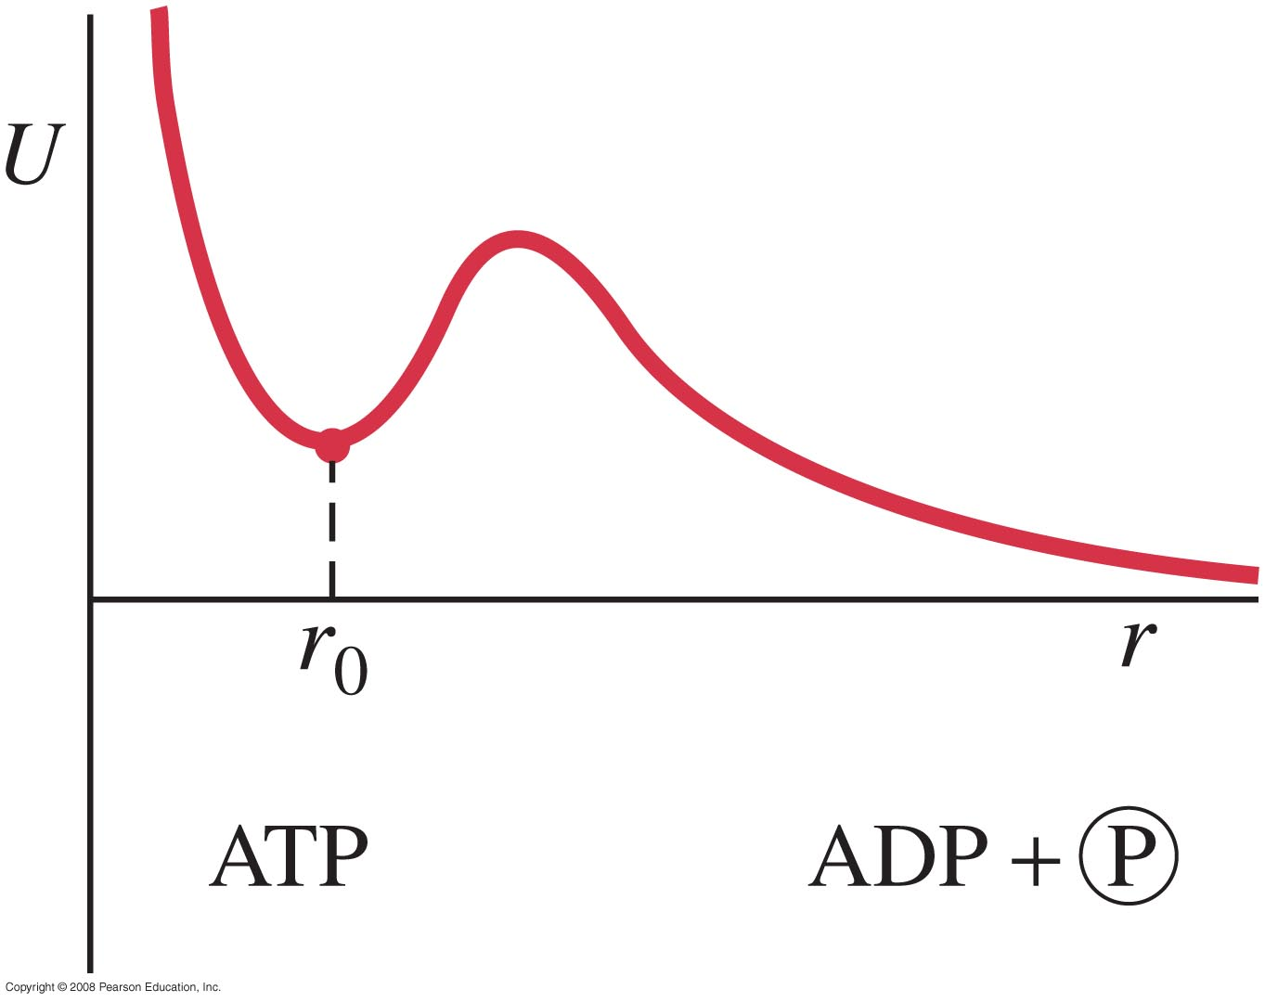
40.2 Potential-Energy Diagrams for Molecules
Sometimes the bond occurs in a configuration that is a local minimum of potential, but that takes energy to reach. This is important in living cells.
endotherme vorming
van ATP
Notes:
Figure 40-11. Potential-energy diagram for the formation of ATP from ADP and phosphate.
ATP Adenosinetrifosfaat
ADP Adenosinedifosfaat

Slide 18
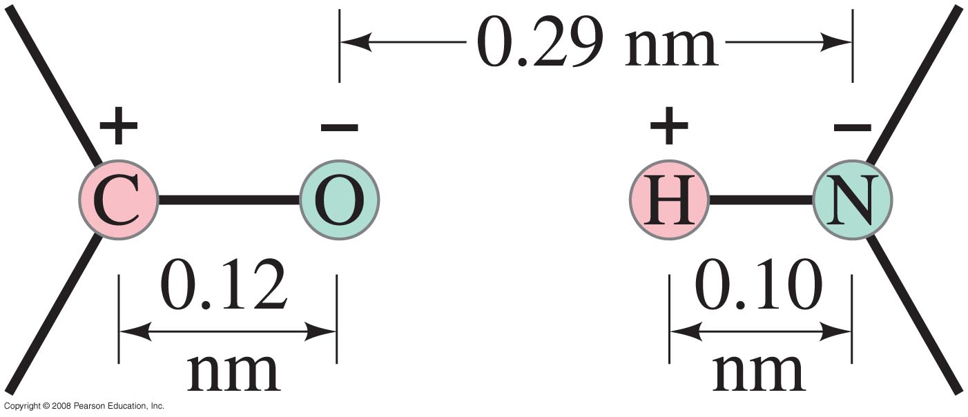
40.3 Weak (van der Waals) Bonds
Weak bonds are electrostatic bonds between molecules (and not between atoms within a molecule). The binding energy is much less than that of strong bonds, about 0.04 to 0.3 eV.
Weak bonds are usually the result of attraction between dipoles.
cytosine
guanine
Notes:
Figure 40-12. The C⁺-O⁻ and H⁺-N⁻ dipoles attract each other. (These dipoles may be part of, for example, cytosine and guanine molecules. See Fig. 40–13.) The + and - charges typically have magnitudes of a fraction of e.
Van der Waals gaat volgens Lennard-Jones potentiaal: E = 4 * epsilon * [ (sigma/r)¹² - (sigma/r)⁶
http://www.imsc.res.in/~sitabhra/teaching/cmp03/class3.html
Slide 32 van http://www.physics.buffalo.edu/phy207/lc/lc41.pdf

Slide 19
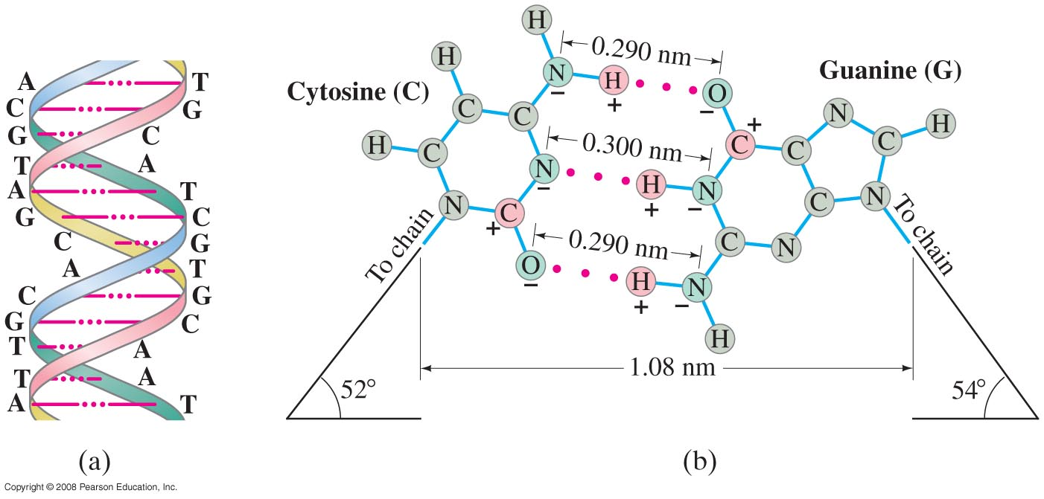
40.3 Weak (van der Waals) Bonds
Weak bonds become important in liquids and solids where strong bonds are absent.
They are also important in living cells, especially in DNA replication.
Notes:
Figure 40-13. (a) Section of a DNA double helix. The red dots represent hydrogen bonds between the two strands. (b) “Close-up” view: cytosine (C) and guanine (G) molecules on separate strands of a DNA double helix are held together by the hydrogen bonds (red dots) involving an H⁺ on one molecule attracted to an N⁻ or C⁺-O⁻ of a molecule on the adjacent chain. See also Section 21–12 and Figs. 21–47 and 21–48.

Slide 20
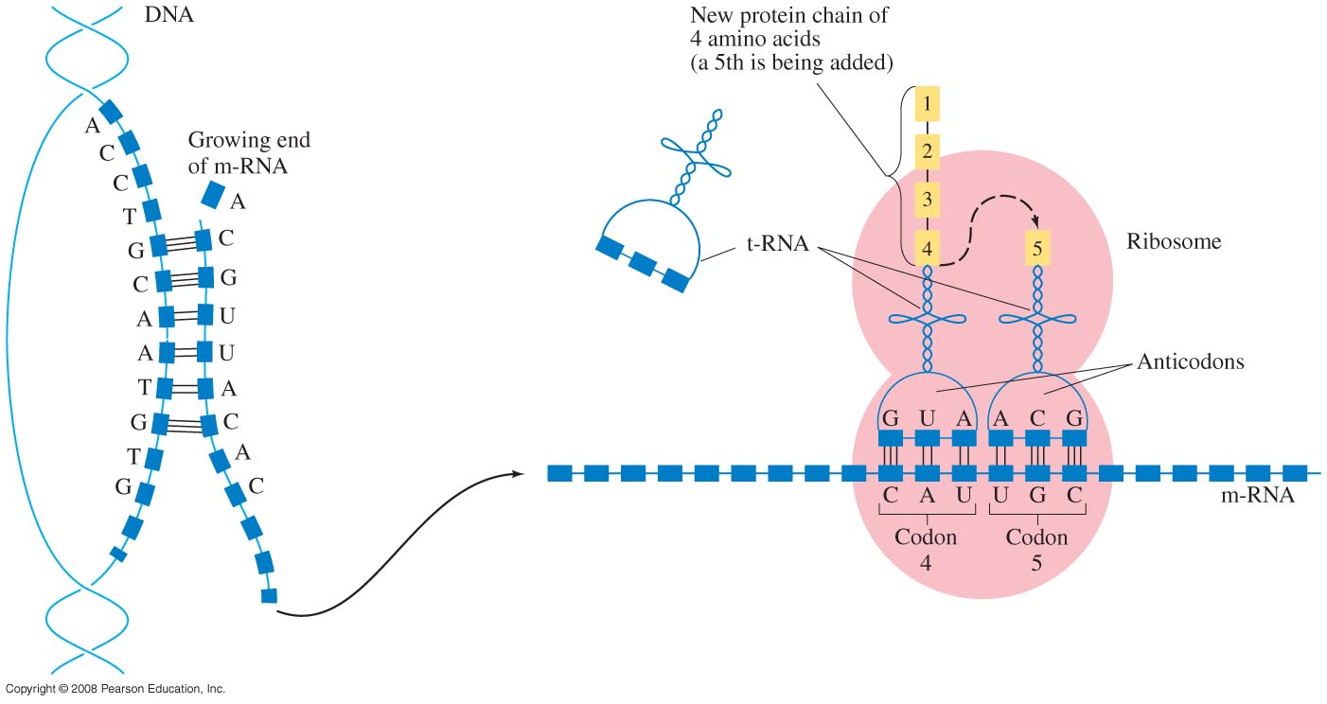
40.3 Weak (van der Waals) Bonds
Protein synthesis involves the breaking of weak bonds and the formation of new ones through random collisions.
aminozuren
Figure 40-14 goes here.
transfer-RNA
messenger-RNA
Notes:
Figure 40-14. Protein synthesis.
DNA 3,6 MB aan info
In DNA komen cytosine (C), guanine (G), adenine (A) en thymine (T) voor.
Nucleïnebasen zijn complementair en vormen basenparen.
RNA bevat de nucleobase uracil (U) in plaats van thymine (T) bij DNA
Ribosomen: buiten de celkern
20 types aminozuren
Transfer-RNA koppelt aan één type aminozuur
Each type of tRNA molecule can be attached to only one type of amino acid, so each organism has many types of tRNA. Because the genetic code contains multiple codons that specify the same amino acid, there are several tRNA molecules bearing different anticodons which carry the same amino acid.
To provide a one-to-one correspondence between tRNA molecules and codons that specify amino acids, 61 types of tRNA molecules would be required per cell. However, many cells contain fewer than 61 types of tRNAs because the wobble base is capable of binding to several, though not necessarily all, of the codons that specify a particular amino acid. A minimum of 31 tRNA are required to translate, unambiguously, all 61 sense codons of the standard genetic code.
http://www.vib.be/nl/biotech-basics/Pages/Eiwitsynthese.aspx

Slide 21
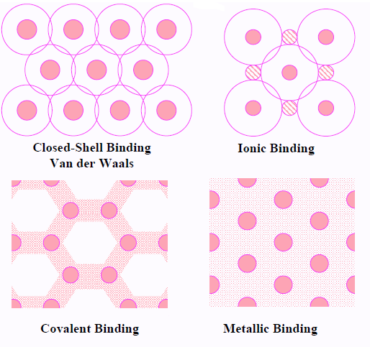
Verschillende soorten binding
dipolen
0.04 á 0.3 eV
gestolen e⁻
3 á 4 eV
gedeelde e⁻
1 á 10 eV
e⁻-zee
1 á 3 eV
http://www.physics.smu.edu/scalise/P5337fa11/notes/ch06/chapter6.pdf
Notes:
Madelung constant properties
http://www.imsc.res.in/~sitabhra/teaching/cmp03/class3.html
Most ionic solids are brittle, have high melting point, insulators and can be dissolved in polar liquids (e.g., water). The characteristic bond energy is 3 - 4 eV.
For simple metals, binding energy is likely to be considerably smaller (~ 1 eV) than in an ionic solid. In transition metals, the d-shell electrons (which are more localised than the s electrons) provide a kind of covalent framework, which forms the main contribution to the binding energy. As a result transition and post-transition metals are as hard as covalent bonded materials.
Relationship between the type of bond and the physical properties of a solid
Melting point: The melting point of solids has an almost monotonically increasing relation with the cohesive energy - e.g., the following substances are arranged in order of increasing melting temperature : Ne (VdW bond), Na (simple metal), Fe (transition metal), KCl (ionic bond), Si (covalent bond).
Electrical and Thermal conductivity: For conducting current, some of the valence electrons must be free to move in response to an electric field - only in metallic bonds are the valence electrons delocalised sufficiently for this to be possible. Hence metals are good electrical conductors. Thermal conductivity is related to electrical conductivity (Wiedemann-Franz relation, first observed in 1853) - hence metals are also good thermal conductors.
Optical properties: Metals reflect light, non-metals are transparent.

Slide 22
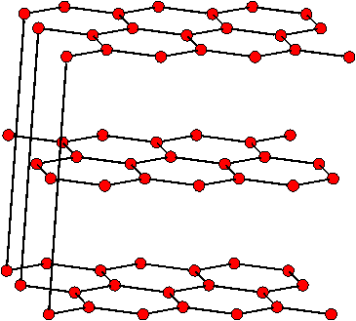
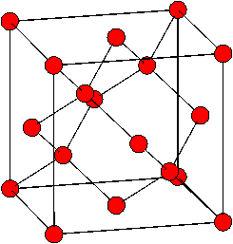
Covalente binding ⬅➔ van der Waalsbinding
diamant
hoogste hardheid
door covalente C-C binding
grafiet
smeermiddel
tussen vlakken: o.a. van der Waalsbindingen
Notes:
The van der waals force only accounts for less than half of the exfoliation energy
a simple van der Waals model is not sufficient for an accurate description of interplanar bonding in graphite, the contribution from van der Waals interactions only accounting for ca. 8meV/C of the cohesive energy compared to the total energy of 20meV/C. The rest of the cohesive energy is provided by a variety of "metallic" interactions that account for the interaction of electrons in one plane interacting with the ions and electrons in neighboring planes of graphite.
http://iopscience.iop.org/article/10.1209/0295-5075/28/6/005/meta
Graphite is simply stacked graphene layers. ○ Nealy 100% ABA stacking. Interlayer separation. Zeq = 3.35 Å.

Slide 23
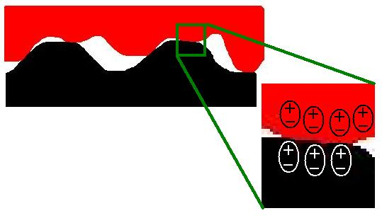
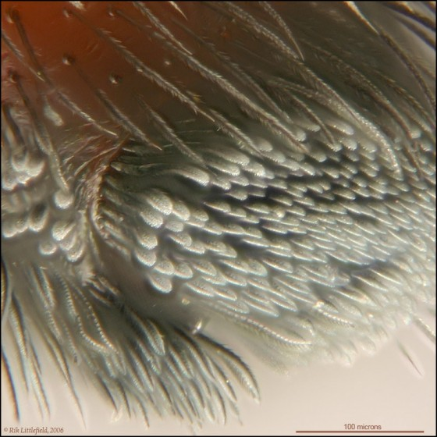
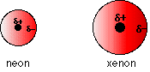
Van der Waalsbinding
geïnduceerde dipool:
klein groter
http://www.chemguide.co.uk/atoms/bonding/vdw.html
Aantrekkingskracht tussen permanente
of geïnduceerde dipolen:
http://www.coolgizmotoys.com/2012/04/gs2-is-it-scientifically-possible-to-climb-walls-like-spiderman.html
spinnenpoot
Notes:
Van der Waals' forces include all intermolecular forces that act between electrically neutral molecules.
Several special cases occur.
Permanent forces http://antoine.frostburg.edu/chem/senese/101/liquids/faq/h-bonding-vs-london-forces.shtml
Hydrogen bonds are abnormally strong dipole-dipole attractions that involve molecules with -OH, -NH, or FH groups. Hydrogen atoms are very small (with an atomic radius of about 37 pm, they're smaller than any other atom but helium). When a bonded electronegative atom (oxygen, nitrogen, or fluorine) pulls electrons away from the hydrogen atom, the positive charge that results is tightly concentrated. The hydrogen is intensely attracted to small, electron-rich O, N, and F atoms on other molecules. (Larger electron-rich groups and atoms (like -Cl, for example) will also attract the hydrogen, but because their electrons aren't as tightly concentrated, the resulting dipole-dipole attraction is too weak to be considered a "real" hydrogen bond.) Hydrogen bonds are essential for building biological systems: they're strong enough to bind biomolecules together but weak enough to be broken, when necessary, at the temperatures that typically exist inside living cells.
faq/h-bonding-vs-london-forces.shtml
http://www.coe.drexel.edu/ret/personalsites/2007/sullivan/VDW_Explained.html
Transitory forces are sometimes called "London forces" in honor of their discoverer. Since all molecules have electron clouds that can oscillate, London forces always contribute to intermolecular attractions. However, they are usually weaker than the permanent forces that they are usually only invoked to explain intermolecular forces between nonpolar molecules or noble gas atoms. However, molecules with large, diffuse electron clouds (like polyatomic anions or molecules containing multiple bonds) can have London forces that are at least as strong as permanent forces are.

Slide 24
Quiz
Welke potentiaal beschrijft de Van der Waalsbinding het best?
Ordegrootte werkingsafstand VanderWaalskrachten: Å

Slide 25
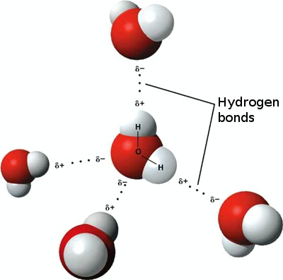
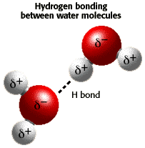
Quiz
Waarom is de H-binding de sterkste van der Waalsbinding?
a) e⁻ wordt over een kleinere oppervlakte ‘uitgesmeerd’.
kernlading wordt slechts afgeschermd door 1e⁻.
Andere moleculen kunnen het dichtst naderen.
Ordegrootte werkingsafstand VanderWaalskrachten: Å

Slide 26
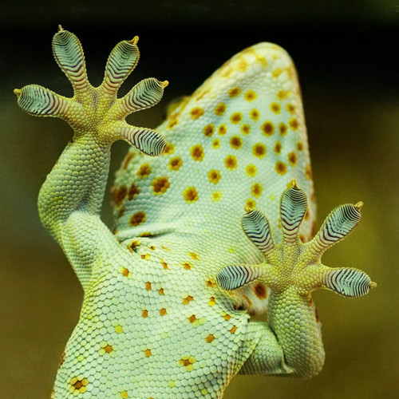
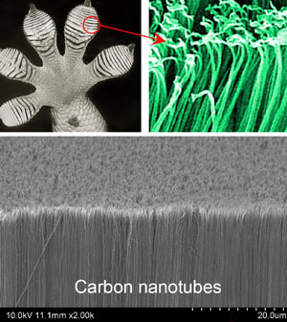
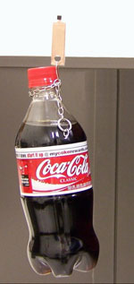
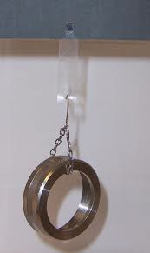
Van der Waalsbinding
Using Lasers to Create Super-hydrophobic Materials:
https://www.youtube.com/watch?v=FLegmQ8_dHg
L Qu et al, Science, 2008, 322, 238
3 cm² nano-tubemateriaal →
houdt 150 kg
http://www.youtube.com/watch?v=hzFQ6LefGCo
http://www.dailymail.co.uk/sciencetech/article-2532664/Rise-lizard-bots-Gecko-like-machines-stick-surfaces-space-soon-crawling-satellites.html
Notes:
http://take-nothing-but-photos.tumblr.com/post/5693064081/geckos-the-ultimate-free-climbers-well-we-knowhttp://www.rsc.org/images/geckopic-300_tcm18-135785.jpg

Slide 27
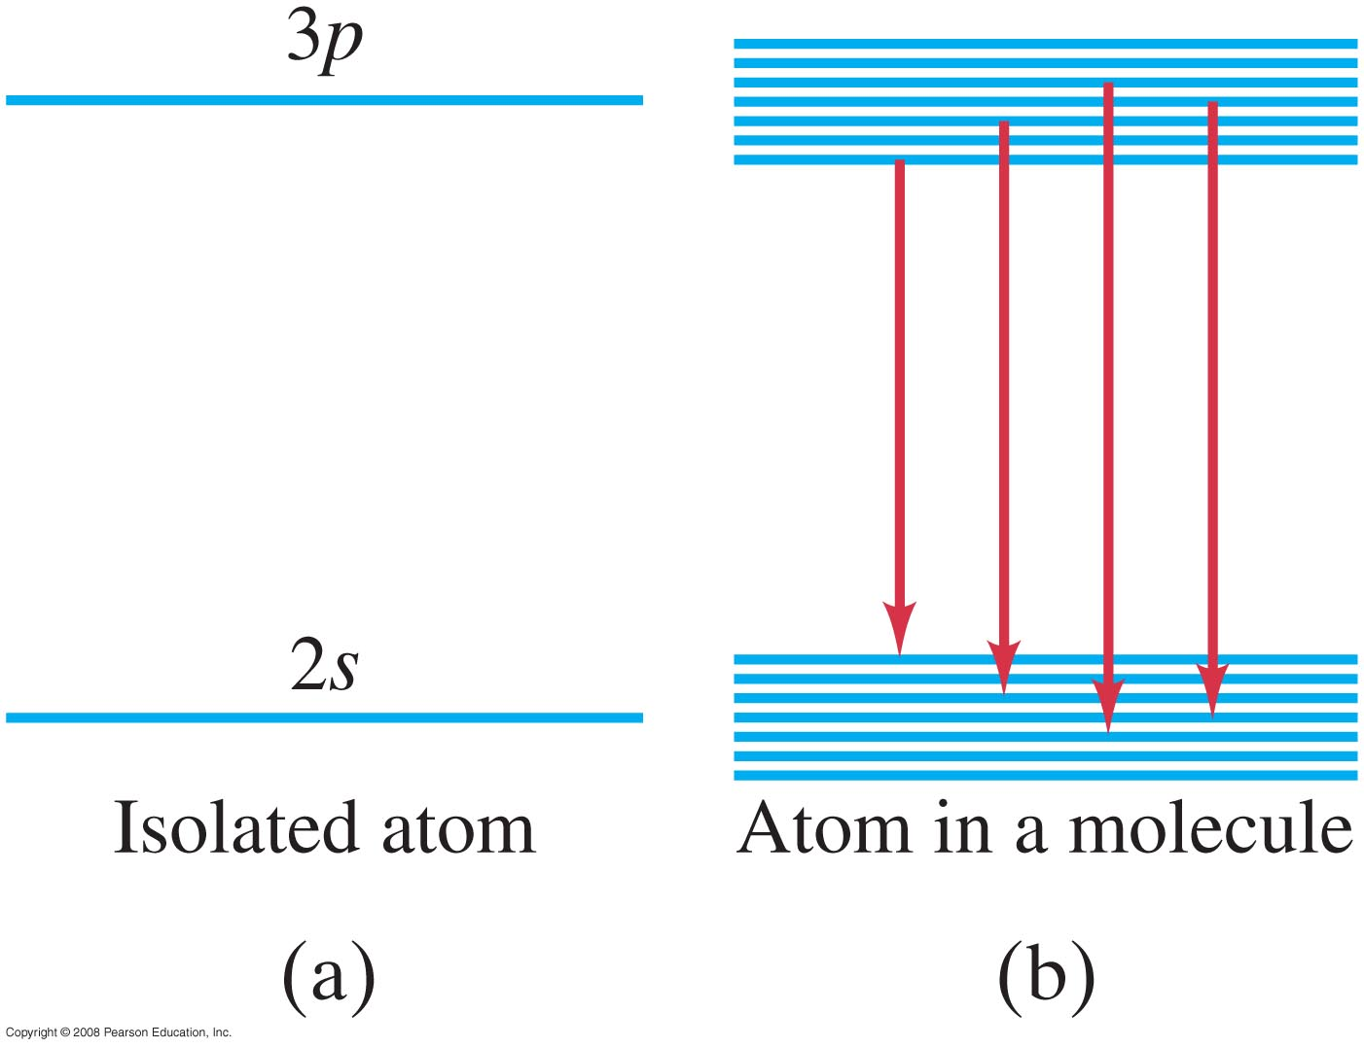
§40.4 Moleculaire spectra
Doordat e⁻-banen gaan overlappen, veranderen de energieniveaus.
Er komen bovendien energieniveaus bij (de niveaus splitsen op) door rotaties en vibraties → resultaat: ‘banden’ met energieniveaus.
Notes:
Figure 40-15. (a) The individual energy levels of an isolated atom become (b) bands of closely spaced levels in molecules, as well as in solids and liquids.

Slide 28
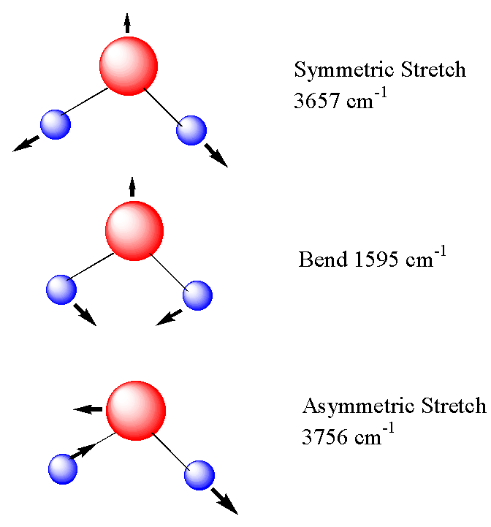
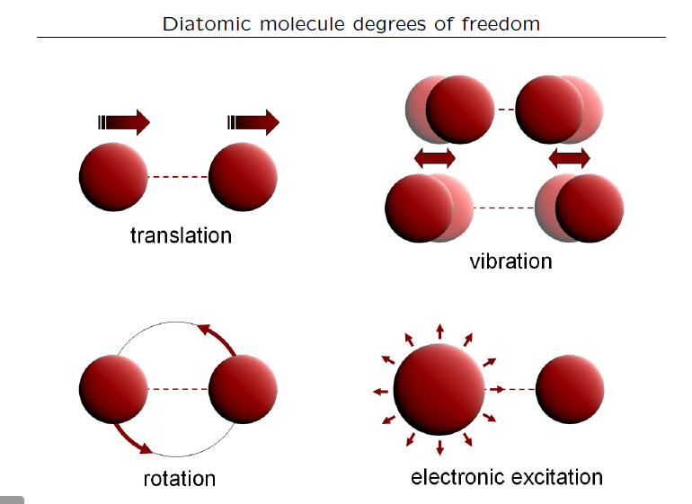
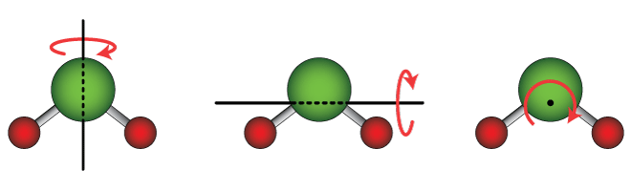
§40.4 Extra vrijheidsgraden van een molecuul
http://pcwww.liv.ac.uk/~awolski/Teaching/Liverpool/PHYS393/StatisticalPhysics-Part3-Handout.pdf
Notes:
Figure 40-15. (a) The individual energy levels of an isolated atom become (b) bands of closely spaced levels in molecules, as well as in solids and liquids.

Slide 29
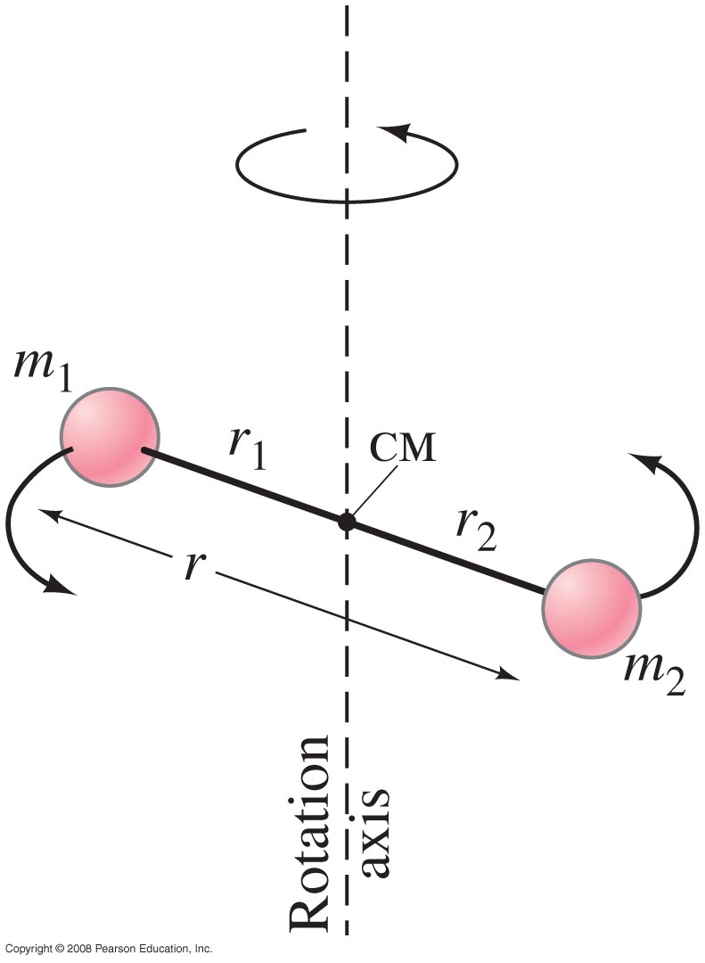
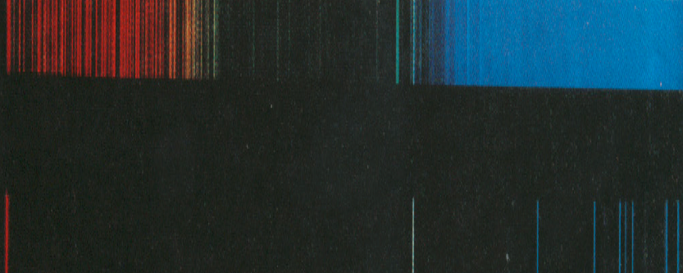
40.4 Molecular Spectra
A diatomic molecule can rotate around a vertical axis. The rotational energy is quantized.
H₂
H
Notes:
Figure 40-16. Diatomic molecule rotating about a vertical axis.
H2: transitions among electronic, vibrational, and rotational states
H: purely electronic transitions

Slide 30
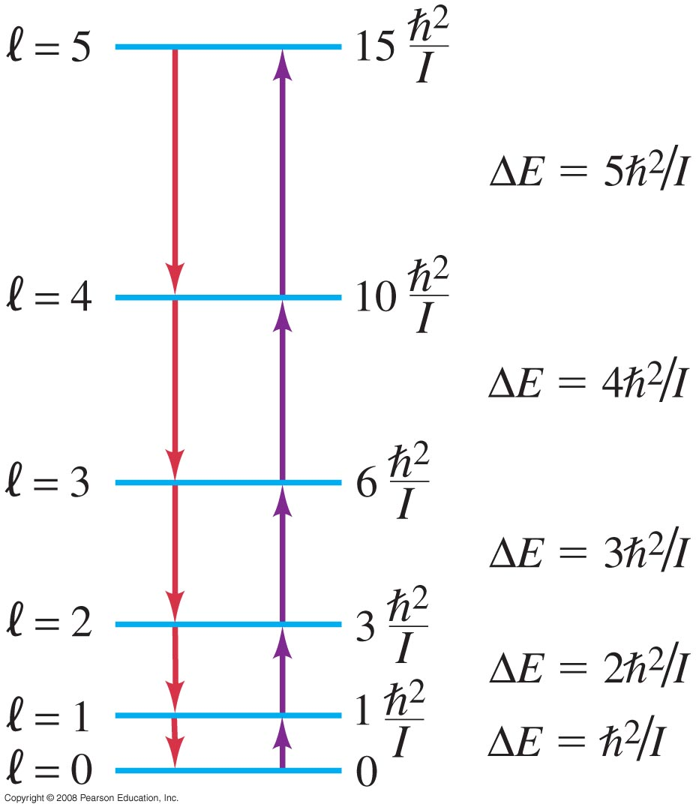
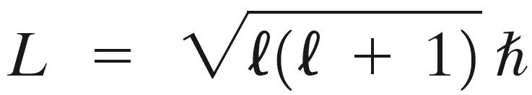
40.4 Molecular Spectra
These are some rotational energy levels and allowed transitions for a diatomic molecule.
Ordegrootte rotatie-energieovergangen: 10 ⁻³ eV
λ ≈ 10 ⁻³ m (microwave)
Notes:
Microgolven (labda ordegrootte mm) Vooral bij gasvormige moleculen zichtbaar!
Figure 40-17. Rotational energy levels and allowed transitions (emission and absorption) for a diatomic molecule. Upward-pointing arrows represent absorption of a photon, and downward arrows represent emission of a photon.

Slide 31
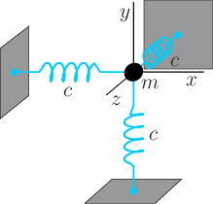
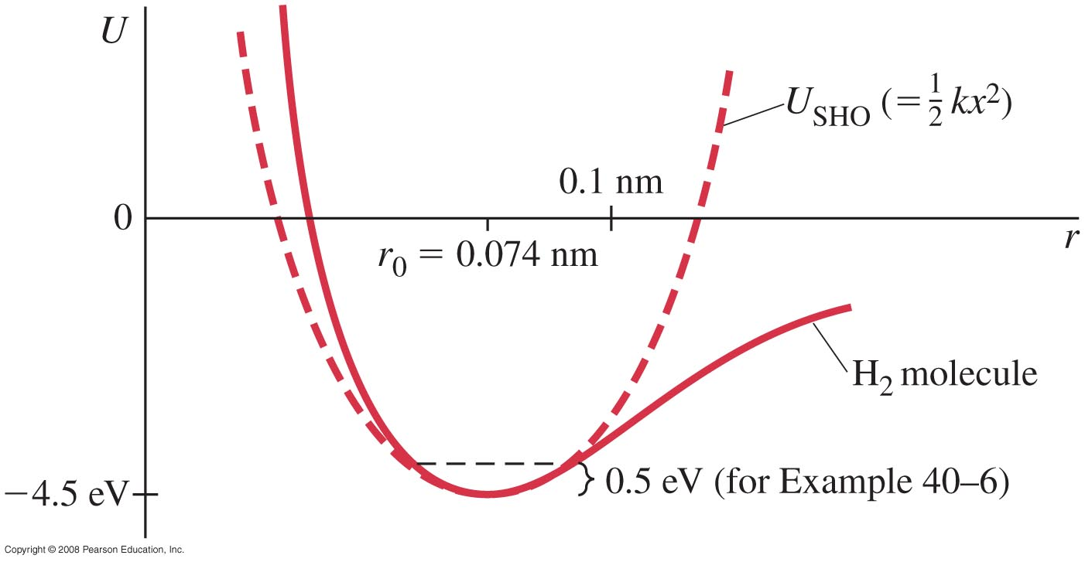
40.4 Molecular Spectra
Small-amplitude vibrations of a diatomic molecule will be simple harmonic. Again, the energy is quantized.
https://en.m.wikipedia.org/wiki/Schrödinger_equation#Harmonic_oscillator
Notes:
In gassen bij lage T http://pcwww.liv.ac.uk/~awolski/Teaching/Liverpool/PHYS393/StatisticalPhysics-Part3-Handout.pdf
Infrarood Vooral zichtbaar bij starre moleculen! Oplosmiddel laat energieniveaus vervagen
Figure 40-18. Potential energy for the H₂ molecule and for a simple harmonic oscillator (U_{SHO} = ½ kx², with |x| = |r – r₀|).The 0.50-eV energy height marked is for use in Example 40–5 to estimate k. [Note that U_{SHO} = 0 is not the same as U = 0 for the molecule.]
Gereduceerde massa: The relative acceleration a_{rel} = a1- a2 between the two bodies is given by a1- a2 = F12 / mu https://en.wikipedia.org/wiki/Reduced_mass
Gereduceerde massa mu: = 1/ (1/m1 + 1/m2) m1 * m2 / (m1 + m2)
Mu_H : m_H/2m_H = ½ m_H
simple harmonicm motion: enkelvoudige harmonische trilling (i.t.t. meer massa’s of Fouriercomponenten)
Bij een enkelvoudige harmonische trilling is de frequentie onafhankelijk van de amplitude.
Many acoustic oscillators, such as the human voice or a bowed violin string, produce complex tones that are more or less periodic, and thus are composed of partials that are near matches to integer multiples of the fundamental frequency and therefore resemble the ideal harmonics and are called "harmonic partials“
Antique singing bowls are known for producing multiple harmonic partials or multiphonics
Partials whose frequencies are not integer multiples of the fundamental are referred to as inharmonic partials.
https://en.wikipedia.org/wiki/Harmonic

Slide 32
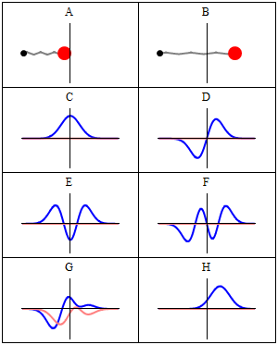
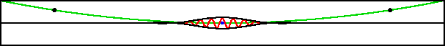
Golffunctie harmonische oscillator
klassiek
kwantummechanisch
E 100 * E₀
Schrödinger:
U ( x ): parabool
https://en.m.wikipedia.org/wiki/Schrödinger_equation#Harmonic_oscillator
http://www.eng.fsu.edu/~dommelen/quantum/style_a/classic.html#harmmvmovie
Notes:
motion of a wave packet whose nominal energy is hundred times the ground state energy
A harmonic oscillator in classical mechanics (A–B) and quantum mechanics (C–H). In (A–B), a ball, attached to a spring, oscillates back and forth. (C–H) are six solutions to the Schrödinger Equation for this situation. The horizontal axis is position, the vertical axis is the real part (blue) or imaginary part (red) of the wavefunction. Stationary states, or energy eigenstates, which are solutions to the time-independent Schrödinger equation, are shown in C, D, E, F, but not G or H.

Slide 33
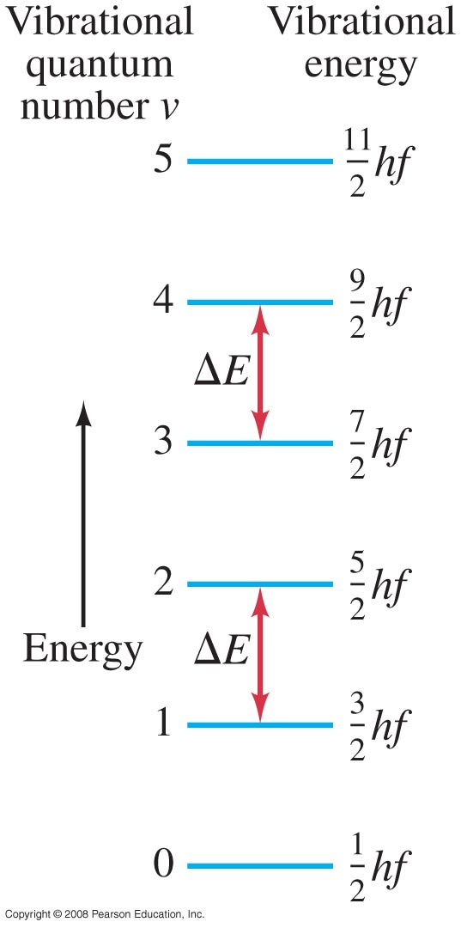
40.4 Molecular Spectra
Here are some vibrational energy levels in a diatomic molecule, and the allowed transitions.
Ordegrootte vibratie-energieovergangen: 0,1 eV
λ ≈ 10 ⁻⁵ m ()
Notes:
Figure 40-19. Allowed vibrational energies of a diatomic molecule, where f is the fundamental frequency of vibration, given by Eq. 40–5.The energy levels are equally spaced, and transitions are allowed only between adjacent levels (Δν = ±1).

Slide 34
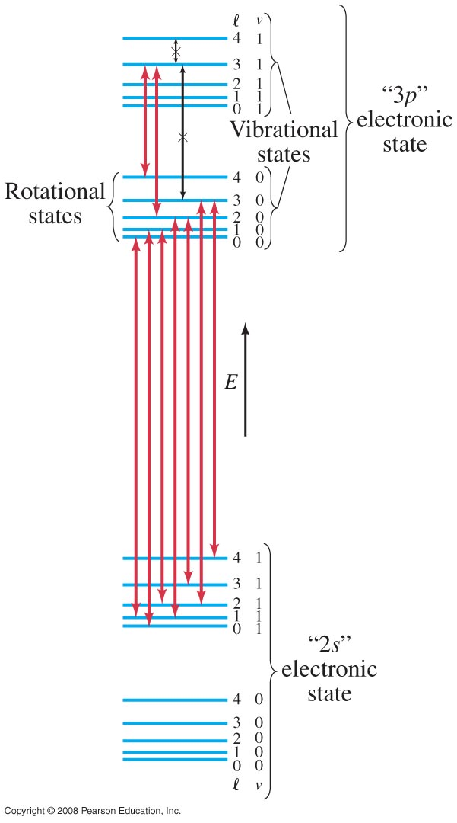
40.4 Molecular Spectra
ν=1
Here we see typical electronic, vibrational, and rotational energy levels in a molecule. The separation between vibrational levels and between rotational levels has been exaggerated for clarity.
ν=0
n=3
l=4
ν=1
l=3
X ➔ verboden overgang
ν=0
n=2
Δν =±1 & Δl = ±1
Notes:
Δελτα λ =±1 : impulsmoment van een foton is 1 (Spin 1-deeltje)
Δελτα νυ =±1 tijdens overgang gedraagt molecuul zich als oscillerende elektrische dipool. Oscillerende magnetische dipool of elektrische quadrupool (Δελτα νυ =±2) is ook mogelijk, maar veel minder waarschijnlijk.
Figure 40-20. Combined electronic, vibrational, and rotational energy levels. Transitions marked with an x are not allowed by the selection rules.
Vergrootte scheiding energienivo’

Slide 35
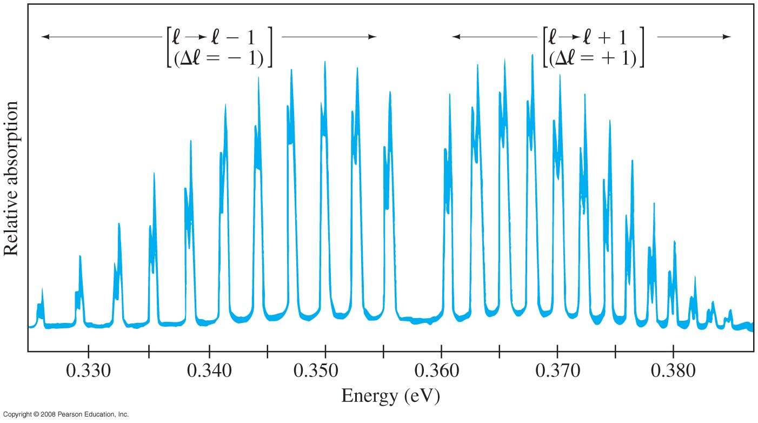
§40.4 Moleculaire spectra
Absorptiespectrum voor HCl-moleculen
dubbele piek
vanwege isotopen
( )
l >0 ➔ geen overgang omlaag vanaf l =0
of omhoog naar l =0
Figure 40-22 goes here.
HCl
l=1 ➔l=0
l=0 ➔l=1
l=2 ➔l=1
l=1 ➔l=2
Notes:
Allemaal dezelfde delta n (zeg n= 3 naar n=2), hierbij delta l mag niet 0 zijn, wel + of -1
Ordegrootte rotatie-energieovergangen: 10 ⁻³ eV
λαβδα ≈ 10 ⁻³ m (microwave)
Figure 40-22. Absorption spectrum for HCl molecules. Lines on the left correspond to transitions where l -> l - 1; those on the right are for l -> l + 1. Each line has a double peak because chlorine has two isotopes of different mass and different moment of inertia. Grotere mu → kleinere delta E.
Gereduceerde massa: The relative acceleration a_{rel} = a1- a2 between the two bodies is given by a1- a2 = F12 / mu https://en.wikipedia.org/wiki/Reduced_mass
Gereduceerde massa mu: = 1/ (1/m1 + 1/m2) m1 * m2 / (m1 + m2)
Mu_H : m_H/2m_H = ½ m_H

Slide 36
Huiswerk
Doorlezen: Giancoli §39.1-6 & §39.8+9; & §40.1-5
Maak Problems: 40_{4,5,10,11,17, 62, 63}
Maak de opgaven uit 'Week 3' in MasteringPhysics.
Huiswerkbespreking: vrijdag
welkom mits voorbereid!
Problem 40.5: Berekenen van effect afscherming door e⁻-wolken op ionbinding:
Bekend: energie nodig om ionen te vormen.
Bindingsenergie blijkt lager dan verschil tussen ionisatie en de Coulomb-aantrekking (te benaderen via: ionen → puntladingen)
Reden van lagere bindingsenergie: e⁻-schillen stoten elkaar af.
Notes:
Li+ ion, F- ion
According to the problem statement, 5.39 eV of energy is required to make an Li+ ion from neutral Li, and 3.41 eV of energy is released when an F atom becomes an F- ion. That means that a net energy input of 5.39 eV – 3.41 eV = 1.98 eV is needed to form the ions. We calculate the negative potential energy of the attraction between the two ions. = -9.21eV
The binding energy should therefore be 9.21 eV – 1.98 eV = 7.23 eV. But the actual binding energy is only 5.95 eV. Thus the energy associated with the repulsion of the electron clouds is 7.23 eV – 5.95 eV = 1.28 eV.

Slide 37
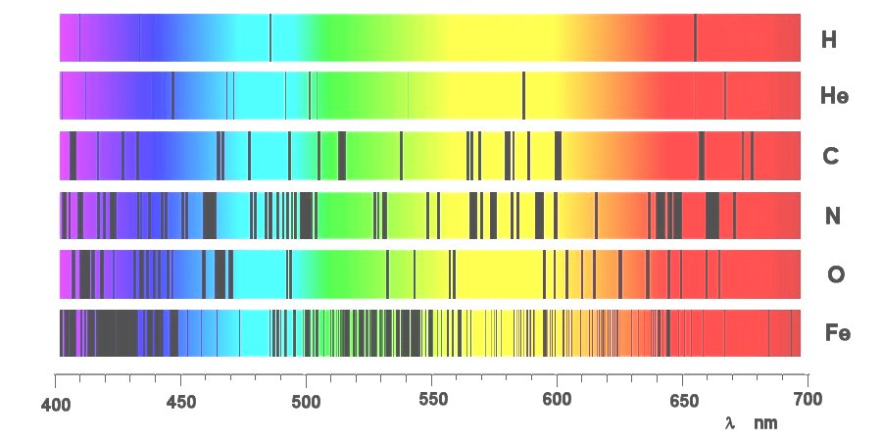
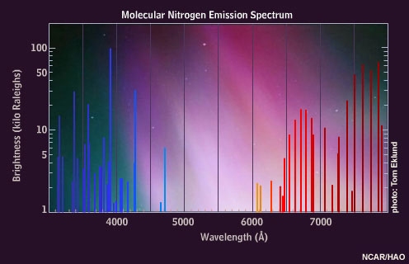

Atomaire versus Moleculaire spectra
21 cm-lijn: elektron flip H-atoom
https://nl.wikipedia.org/wiki/21_cm-lijn
Notes:
Li+ ion, F- ion
According to the problem statement, 5.39 eV of energy is required to make an Li+ ion from neutral Li, and 3.41 eV of energy is released when an F atom becomes an F- ion. That means that a net energy input of 5.39 eV – 3.41 eV = 1.98 eV is needed to form the ions. We calculate the negative potential energy of the attraction between the two ions. = -9.21eV
The binding energy should therefore be 9.21 eV – 1.98 eV = 7.23 eV. But the actual binding energy is only 5.95 eV. Thus the energy associated with the repulsion of the electron clouds is 7.23 eV – 5.95 eV = 1.28 eV.

Slide 38


Vaste-stoffysica
Symmetrieën → eigenschappen vaste stof
Notes:
http://www.coolgizmotoys.com/2012/04/gs2-is-it-scientifically-possible-to-climb-walls-like-spiderman.html

Slide 39


Amorfe stoffen
IJs dichtbij smelttemperatuur: http://mini.physics.sunysb.edu/~marivi/TEACHING-OLD/PHY313/doku.php?id=lectures:7
Notes:
http://www.steelguru.com/article/details/MjU%3D/Solid_State_Structure.html
http://mini.physics.sunysb.edu/~marivi/TEACHING-OLD/PHY313/doku.php?id=lectures:5

Slide 40




Amorfe stoffen
Notes:
http://www.ieong.net/ee3106/Lecture1.pdf
Grain boundary : Korrelgrens

Slide 41





Amorf silicium ⬅➔ kristallijn silicium
kristallijn Si
rood: één eenheidscel
99.9999999%
zuiverheid
monokristallijn
⬇ polykristallijn
amorf Si
blauw: vaste-stof-achtig
groen: vloeistof-achtig
Notes:
http://www.weizmann.ac.il/chemphys/bouchbinder/ri.html
Visualization of the composition of a computer simulated amorphous silicon in terms of solid-like (blue) and liquid-like (green) atomic environments, courtesy of M. Demkowicz (see also Phil. Mag. 86, 4153 (2006)). A theoretical analysis of the deformation of this simulated amorphous silicon is presented in Phys. Rev. E 75, 036107 (2007).
Kunsmatige diamantstructuur ge-etst in silicium (fotonisch kristal): http://www.stw.nl/Nieuws/20111103.htm

Slide 42
Quiz
Welke potentiaal beschrijft de reactie van knalgas het best?

